Slide 1
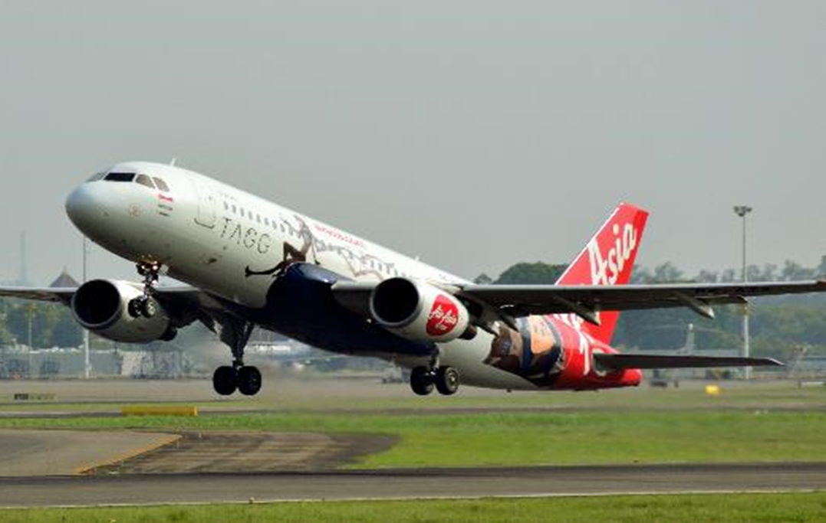
FLIGHT FARE PREDICTION
Presented by:
KV Pradeep

Slide 2
PROBLEM STATEMENT
The project is to collect data on flight fares from available features and work to make a model to predict the fares of flights.
Due to Economic pricing & people wanting to travel in a short period of time, the Airline industry has seen a rise in ticket booking during this decade.
The airfares dramatically vary depending on time & demand of purchase of tickets.
Proper scheduling & good knowledge of airfares can help economic passengers have good value for money on their travel.

Slide 3
INTRODUCTION
From the dataset, we get to know that it is a Regression problem and the Price of Flight varies based on its properties and there are so many features that will help to find it.
As per the problem statement Target Variable i.e., continuous. So, we will use regression to learn our model
The following are the regression techniques used to predict this model:
Decision Tree Regression
Random Forest Regression
XGBoost Regression

Slide 4
FEATURES
1. Airline:- Name of the airline used for traveling.
2.Date_of_Journey:- Date at which a person traveled.
3. Source:- Starting location of the flight.
4. Destination:- Ending location of the flight.
5. Route:- This contains information on starting and ending location of the journey in the standard format used by airlines.
6.Dep_Time:- Departure time of flight from starting location.
7. Arrival Time:- Arrival time of flight at the destination.
8. Duration:- Duration of flight in hours/minutes.
9. Total Stops:- Number of total stops the flight took before landing at the destination.
10. Additional Info:- Shown any additional information about a flight.
TARGET
11. Price:- Price of the flight.

Slide 5
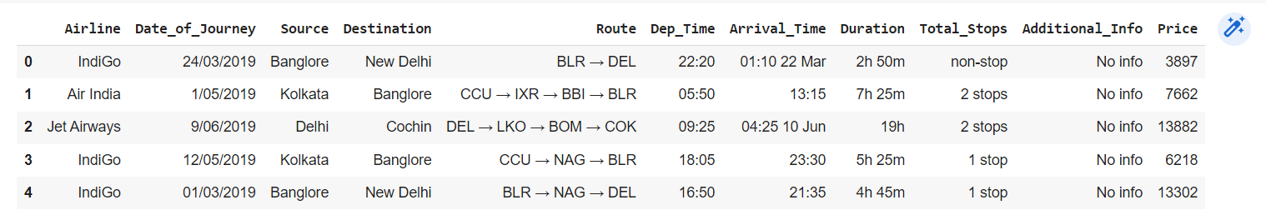
METHODOLOGY
The following are the types of variables present in data:
Dependent Variable
Independent Variable
The shape of this data is 10683 rows and 11 columns.
This is the head of the dataset

Slide 6
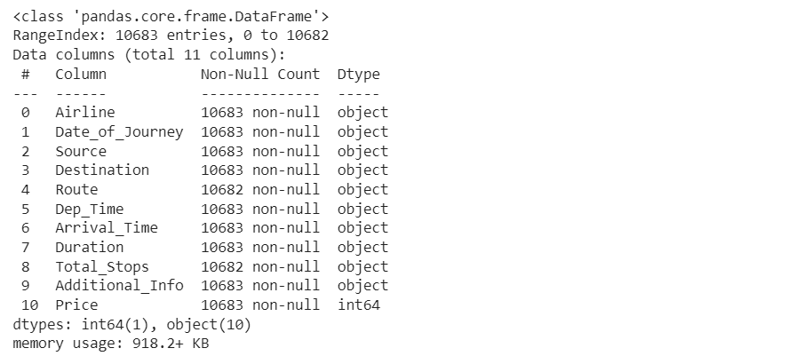
METHODOLOGY
We can run train.info() command, which gives us the information about number of values present in each column,and data types of each column.
We observe that we have all the columns as ‘object’ data types, and only ‘Price’ column (the output) is of integer type.Since we know what our column signify ,We know which columns we need to treat !

Slide 7
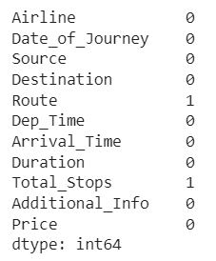


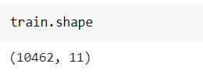
METHODOLOGY
There are 220 duplicate values in the data.
The duplicates present in the dataset are removed.
After dropping the duplicate values, the shape of the data is changed to 10462 rows and 11 columns.
There are null values in ‘Route’ and ‘Total_Stops’.
At initial stage of the data cleaning process, the null values are dropped.

Slide 8
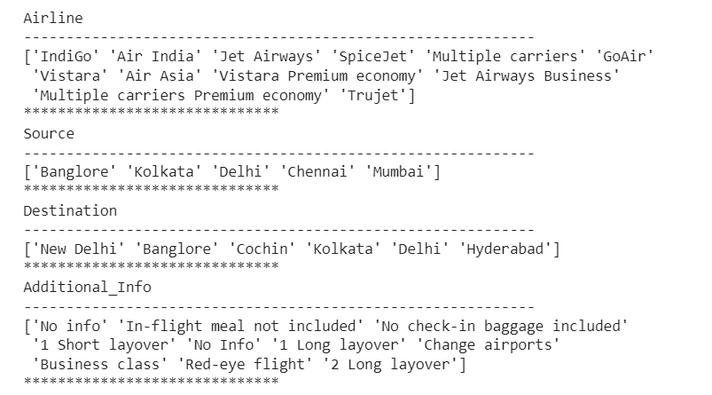
METHODOLOGY
Airline column has 12 unique values.
Source column has 5 unique values.
Destination column has 6 unique values
Additional_info column has 10 unique values.

Slide 9
METHODOLOGY
We converted ‘Date_of_Journey’ column into ‘Journey_day’ and ‘Journey_month’.
After extracting ‘Journey_day’ and ‘Journey_month’ , we can drop ‘Date_of_Journey’ column.
Let’s extract values from Dep_Time.Departure_Time means when a flight leaves the airport and this column contains hours and minutes so we will extract hours and minutes from ‘Dep_Time’.
Similarly we can extract hours and minutes from ‘Arrival_Time’ column.
‘Duration’ column is not in an appropriate form to help predict machine learning model.We have to bring it in a same format.There in dataset some flight duration could be just ‘30m’ so we will write it as ‘0h 30m’ . So we extract two new columns ‘Duration_hours’ and ‘Duration_mins’ from ‘Duration’
We can Drop ’Dep_Time’,’Arrival_Time’ and ‘Duration’ columns as they are of no use.

Slide 10
METHODOLOGY
‘Airline’ column has 12 unique values,‘Source’ column has 5 unique values and ‘Destination’ has 6 unique values
As all the three columns are Nominal categorical data we will perform ‘OneHotEncoding’.
We can drop all the three columns as they are of no use.
‘Additional_Info contains almost 80% no_Info, so we will drop the columns.
Also ‘Route’ and ‘Total_Stops’ are related to each other. So we will drop ’Route’ columns.
‘Total_Stops’ has 5 unique values as it is Ordinal categorical type we perform ‘LabelEncoder’. Values are assigned with corresponding keys.
Final data we have is with 10462 rows and 30 columns.
All the Exploratory data analysis that we did for train dataset we will do it for test dataset.

Slide 11
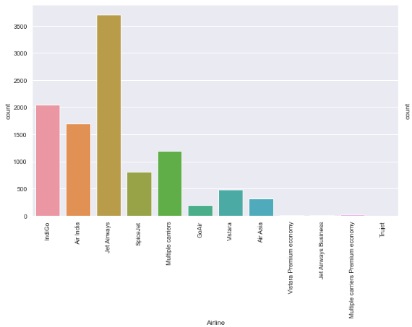
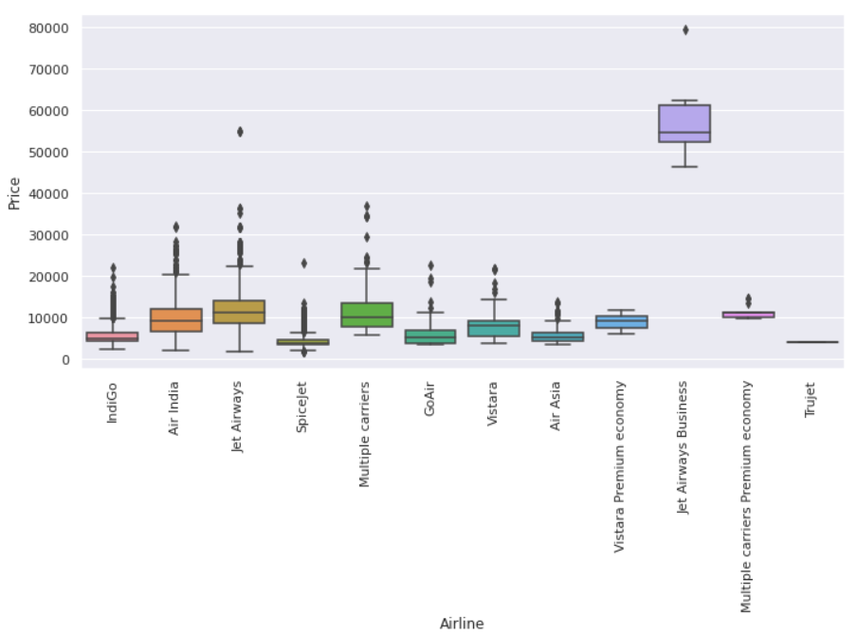
METHODOLOGY
Jet airways is the most preferred airline with the highest row count,followed by indigo and Air India. Jet Airways business is the costlier airways.
Count of Trujet,Vistara premium,multiple carries premium and Jet airways business is very low
As we can see the ‘Jet Airways business’ has highest price range when compared to other Airlines.

Slide 12
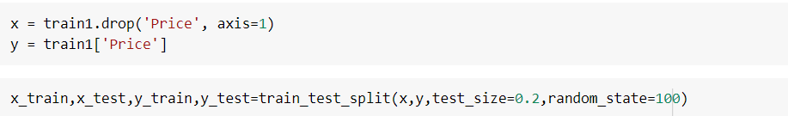
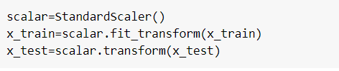
MODEL TRAINING
SCALING OF DATASET
We drop the ‘Price’ column from train dataset and make independent variable(y) to find the correlation between dependent and independent data.
We have splitted dataset into 80:20 format i.e, 80% for Training and 20% for Testing.
Scaling the data using StandardScaler method is used to overcome the with the issue of data biasness and displayed the data of independent variables after scaling.

Slide 13
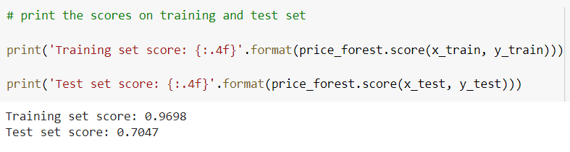
MODEL BUILDING
Decision Tree Regressor:
Using Decision Tree classifier we got 96% Training Accuracy & 70% Testing Accuracy
But from this information we say that our Model with Decision Tree Classifier is Overfitting,because there is Huge difference between Training accuracy and Testing accuracy.

Slide 14
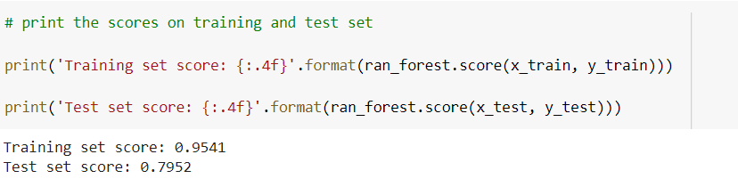
MODEL BUILDING
Random forest without HyperParameter tuning:
We got 95% Training Accuracy & 79% Testing Accuracy
We can see by changing the Algorithm we got some improvement in Accuracy but still it is Overfitting.

Slide 15
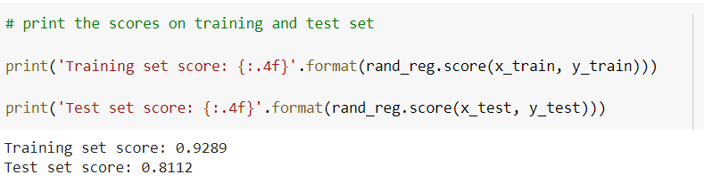
MODEL BUILDING
Random forest with HyperParameter tuning:
Now we got 92% Training Accuracy & 81% Testing Accuracy.
As we can see ,we have reduced some effect of Overfitting by using HyperParameter Tuning.

Slide 16
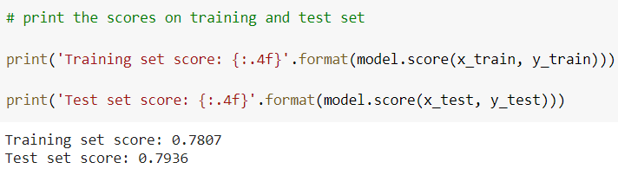
MODEL BUILDING
XGBoost without HyperParameter tuning:
Now we got 78% Training Accuracy & 79% Testing Accuracy.

Slide 17
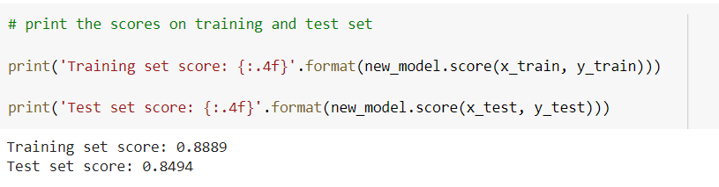
MODEL BUILDING
XGBoost with HyperParameter tuning:
Now we got 88% Training Accuracy & 84% Testing Accuracy.
We got good accuracy in this model when compared to other model.

Slide 18


